Slide 1
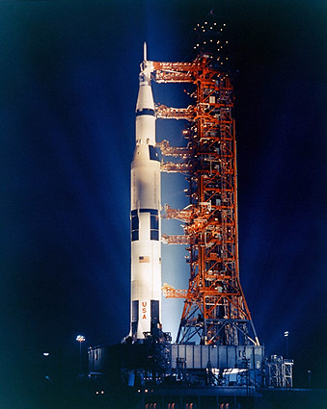
SPACE EXPLORATION MERIT BADGE
Your Merit Badge Counselor (Me) : Gregg Dorn
2:00 to 2:30 History of Space Exploration.
Fill Out Blue Cards
2:30 to 3:00 <<< Build Rockets >>>
3:00 to 4:00 Evolution of Space Technology
Space Science
4:00 to 5:15 <<< Launch Rockets >>>

Slide 2
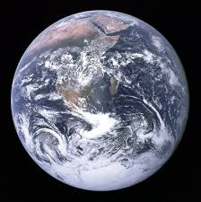
Why Do We Want to Go To Space????
Earth is a pretty nice place, after all…
Scientific Knowledge Benefits related to Earth resources, technology, and new products. International relations and cooperation
Backup Plan ?
5 mass extintions

Slide 3
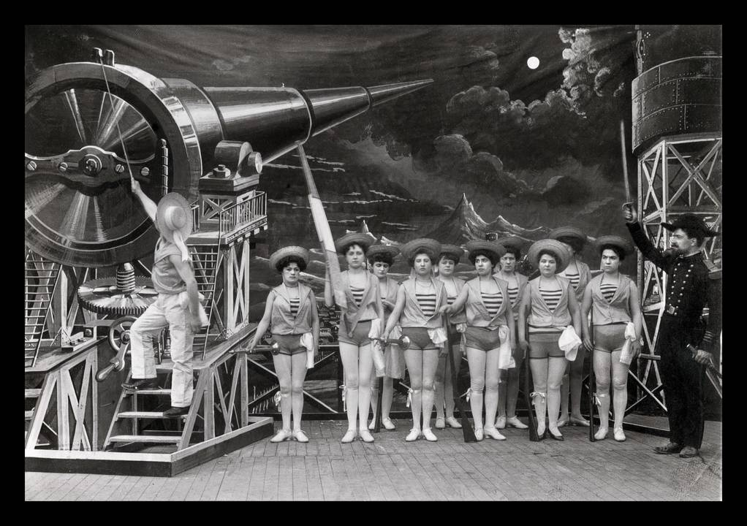
Where did it all start?????
1865 Jules Verne's From the Earth to the Moon and H. G. Wells' The First Men in the Moon.
A Trip to the Moon (French: Le Voyage dans la Lune), alternately Voyage to the Moon, is a 1902 French black-and-white silent science fiction film.
REALISTIC????
NO: In 1961 Project HARP cannon shot (400 lb) projectile 180 kilometres 1/3 of escape velocity. 25,000 Gs

Slide 4
Early Days…
1903 Paper mathematically demonstrates liftoff with liquid fuels
Konstantin Tsiolkovsky publishes a paper in Russia that mathematically demonstrates how to achieve liftoff with liquid fuels. He also proposes using multistage rockets, guidance systems using gyroscopes and movable fins.
His formulas for adjusting a spacecraft’s direction and speed to place it in any given orbit are still in use today.
1915 Robert Goddard establishes that it is possible to send a rocket to the Moon
Robert Goddard experiments with reaction propulsion in a vacuum and establishes that it is possible to send a rocket to the Moon.
Goddard launches the first liquid-fuel rocket.

Slide 5
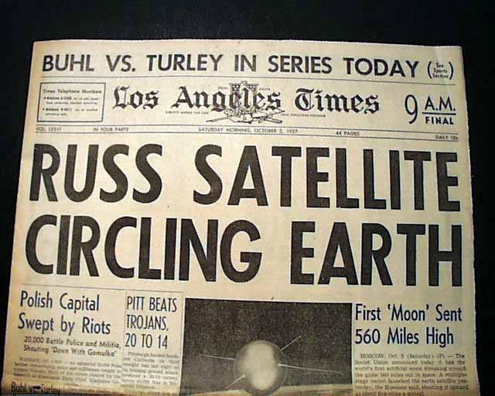
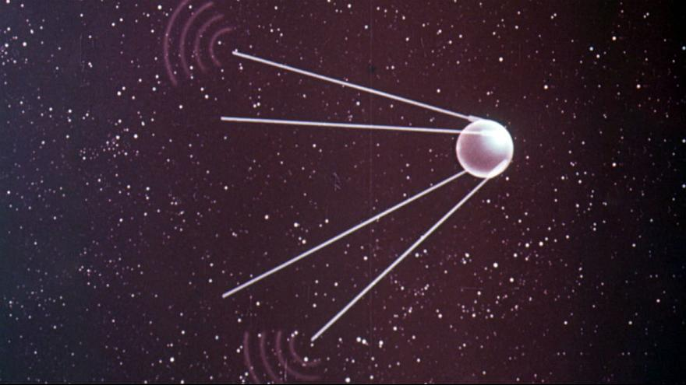
1st Space Age: Competition (bad)
Oct 1957 First Artificial Satellite
Sputnik I, 184 pounds, Size of a Basketball, 98-minute orbit
April 1961 First human in space
Vostok I, Yuri Gagarin, One Orbit
May 1961 Second human in space
Alan B. Shepard, Freedom 7 on Mercury-Redstone, < 1 orbit
1962 First American to circle Earth
John Glenn, Friendship 7 on Mercury 3, Orbits
1969 First person to walk on the Moon
Neil Armstrong becomes the first person to walk on the Moon. The first lunar landing mission, Apollo 11

Slide 6
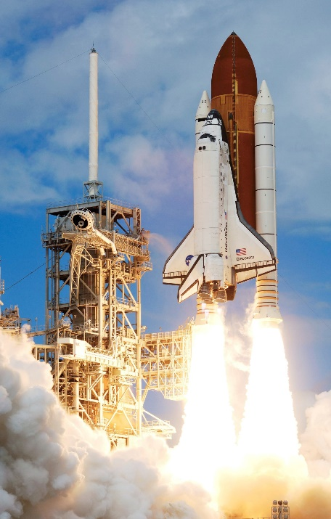
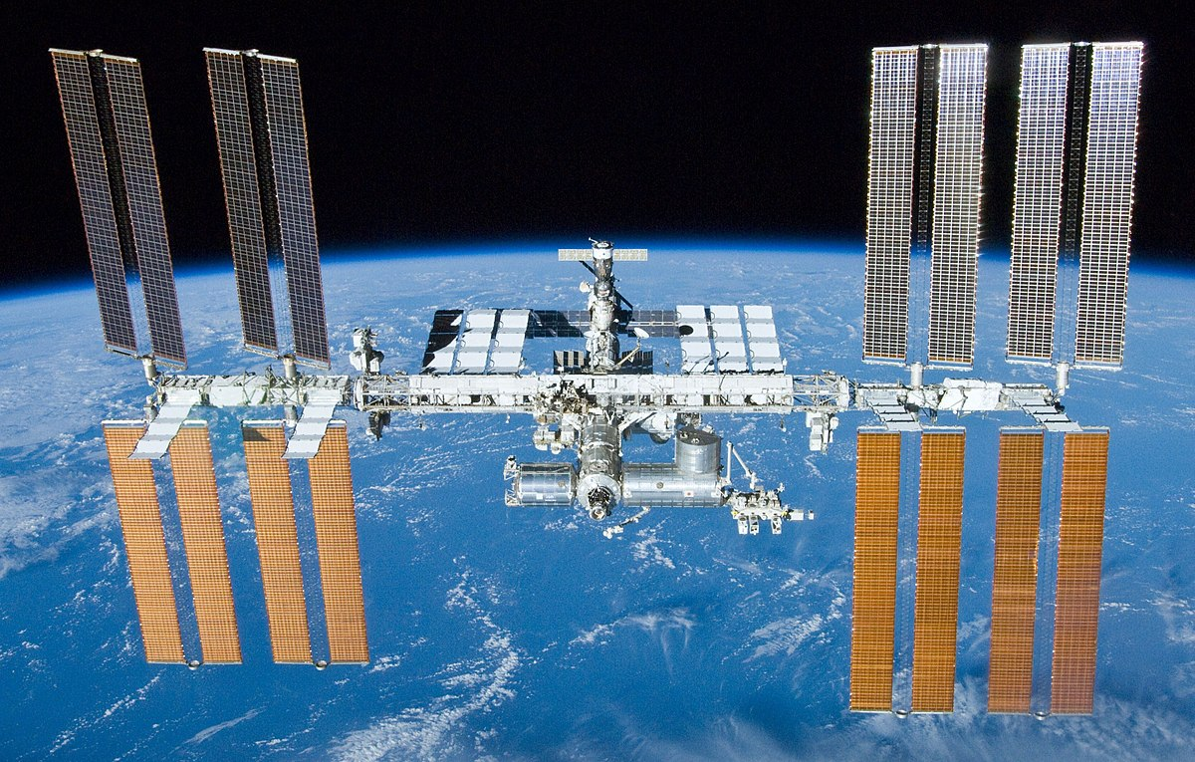
2nd Space Age: Exploration
, 1973, 1974 Pioneer 10,12,12 sent to the outer solar system
1975 Viking 1, Viking 2 sent to Mars
1977 Voyager I and Voyager 2 are launched on trajectories that take them to Jupiter and Saturn
3rd Space Age: Advancement
Space Shuttle Columbia is launched
Reusability,
Solid Rocket Boosters
4th Space Age: Cooperation
1990 Hubble Space Telescope
1998 First Parts of International Space Station
2000 Expedition One to The International Space Station

Slide 7
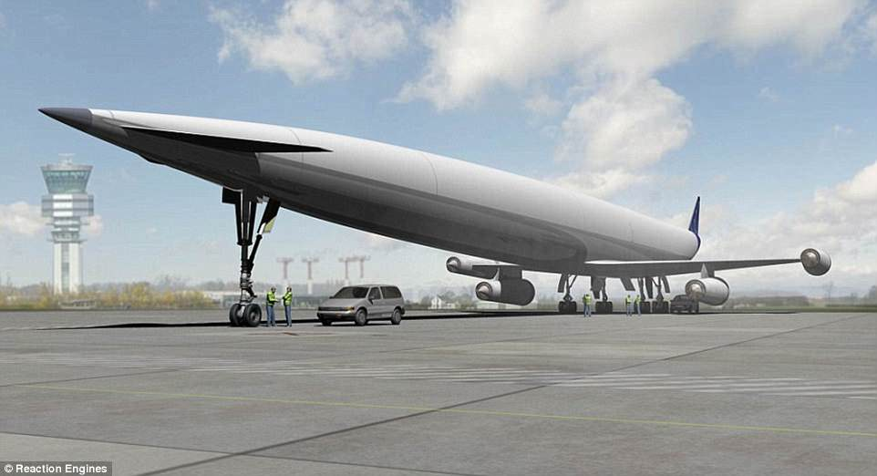
5th Space Age:
(Now)
Commercialization and privatization
(good)
Competition in a good way
Companies see profit in space and are motivated
Advancements are now coming faster and faster.

Slide 8
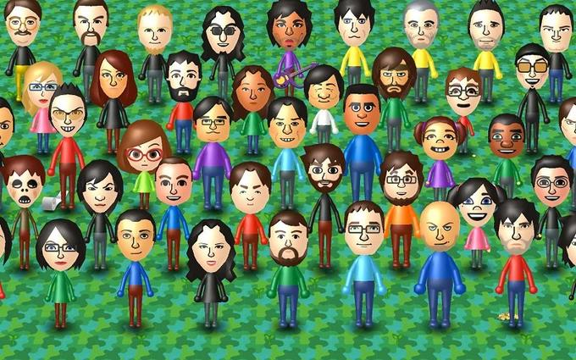
So who is involved?
How many supported Apollo Program?
Less than 10
Less than 1,000
Less than 10,000
Less than 100,000
Less than 1,000,000
What type of careers are related to space flight???
Who is someone you know about?

Slide 9
400,000 People
Flight directors
Software Programmers
Suit Makers
Ground Crews
Technicians
Engineers
Support Industry: Cooks, Cleaning, etc.
On and On…
Oh, and don’t forget Astronauts

Slide 10
<<Build Rockets>>

Slide 11
Why is going into space so hard????

Slide 12
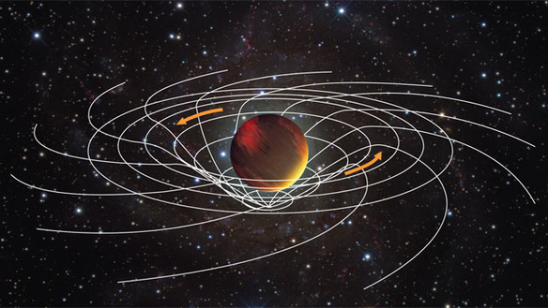
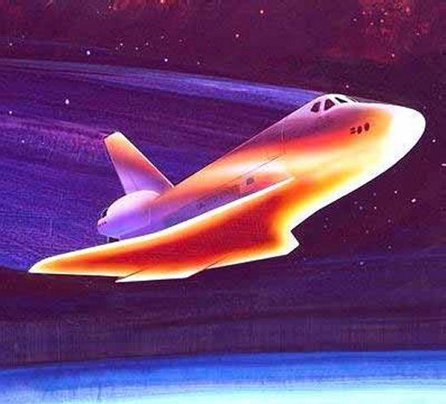
HURDLES:
Gravity (wells)
Atmosphere
Physics
Human
Technology
Cost

Slide 13
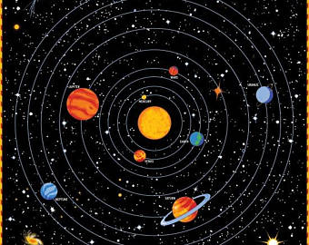
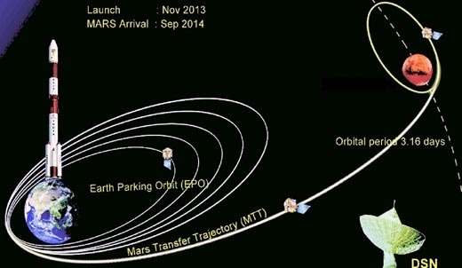
Orbital Mechanics 101:
We are always Orbiting Something.
Orbital Mechanics is about switching between orbits

Slide 14
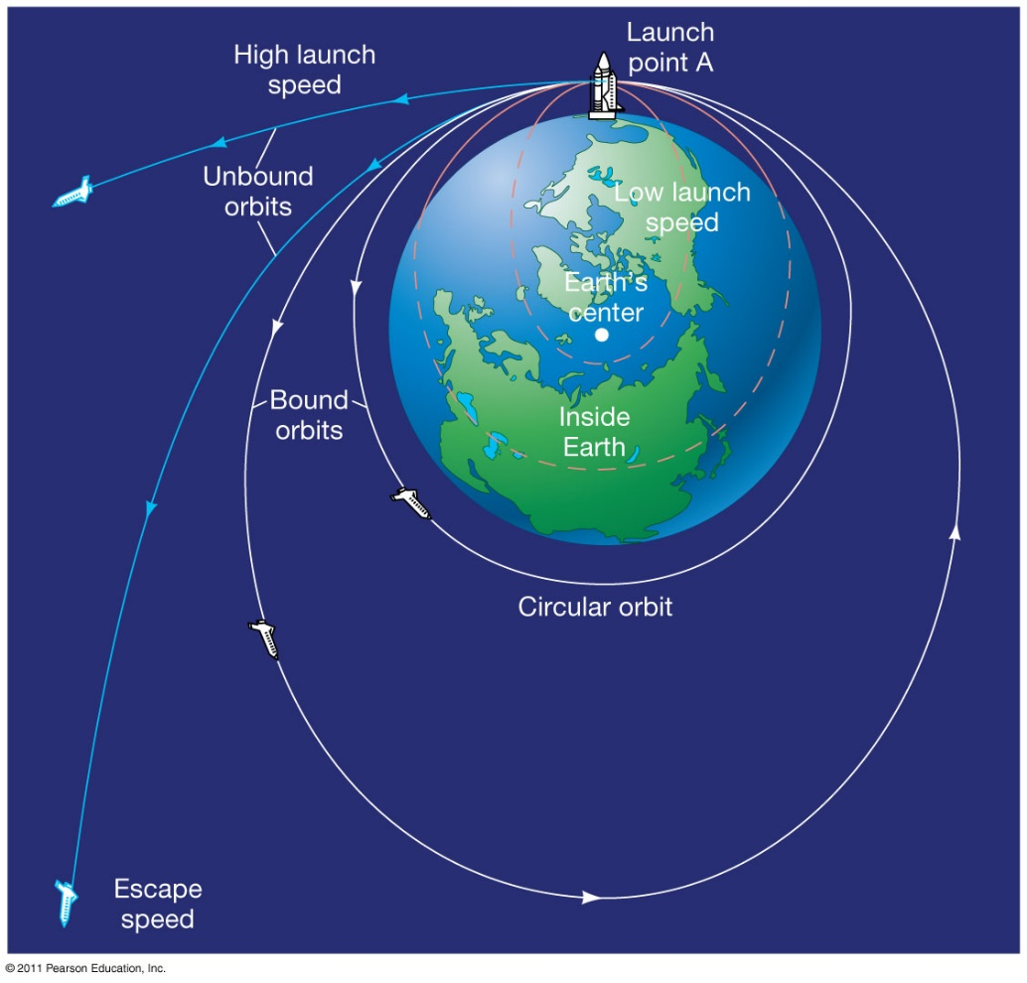
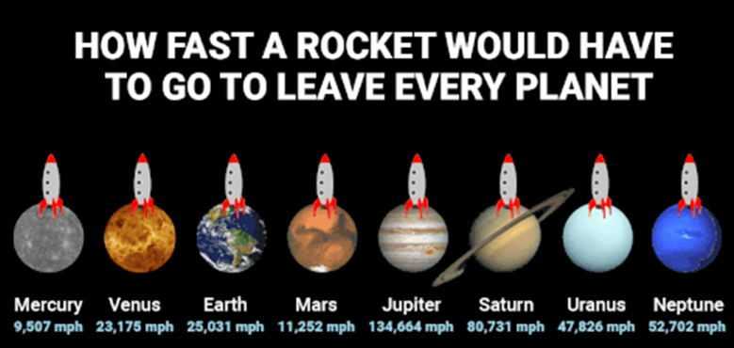
To transfer to different orbits, you achieve enough escape velocity to reach another planets gravity well.

Slide 15
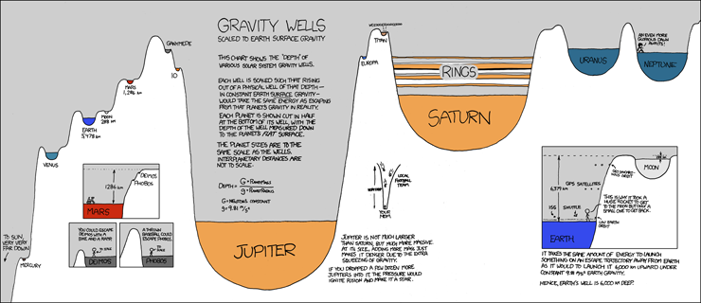

Slide 16
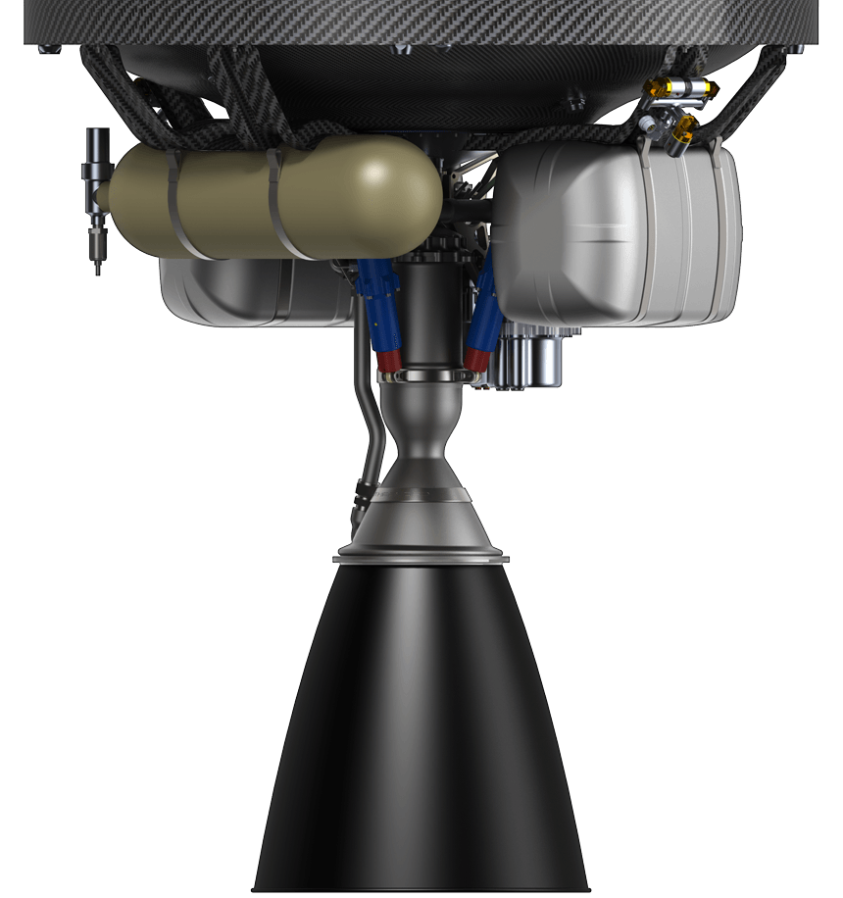
Ok, so how do Rockets Work??

Slide 17
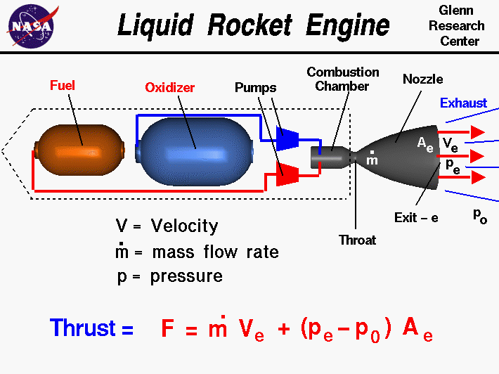
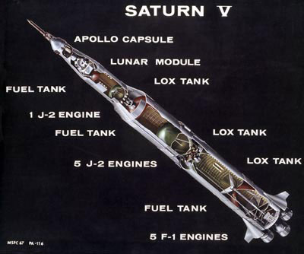
Key Requirements: Controllable Engines and Steering (and the ability to restart is nice)
Fuel, Oxygen, Fuel, Oxygen
What??? We have to bring our own oxygen??

Slide 18
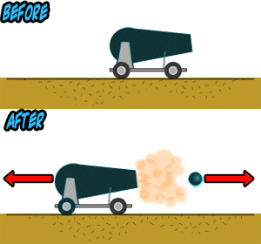
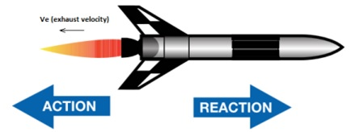
But how do they work in a vacumm….
How do rockets move in space with nothing to push on?????

Slide 19
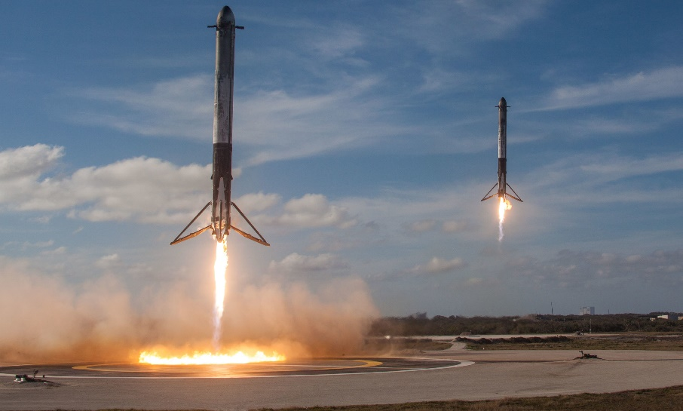
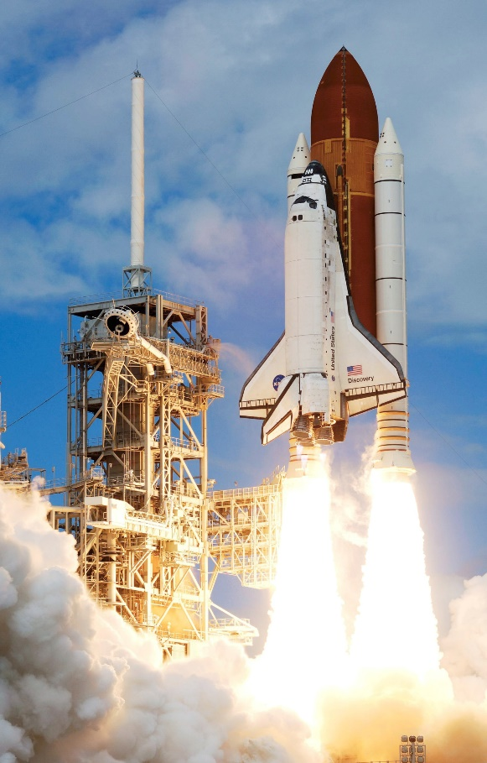
Reducing Cost is the Key, Reusability is the answer
The Gold Standard: SSTO
Single Stage To Orbit

Slide 20
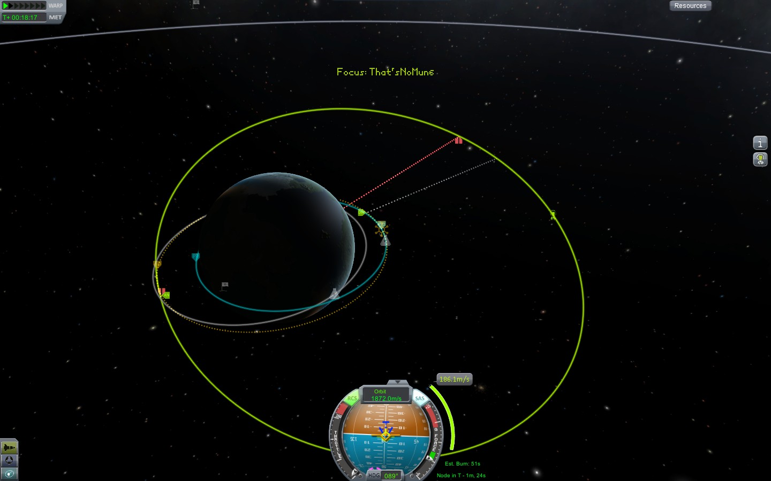
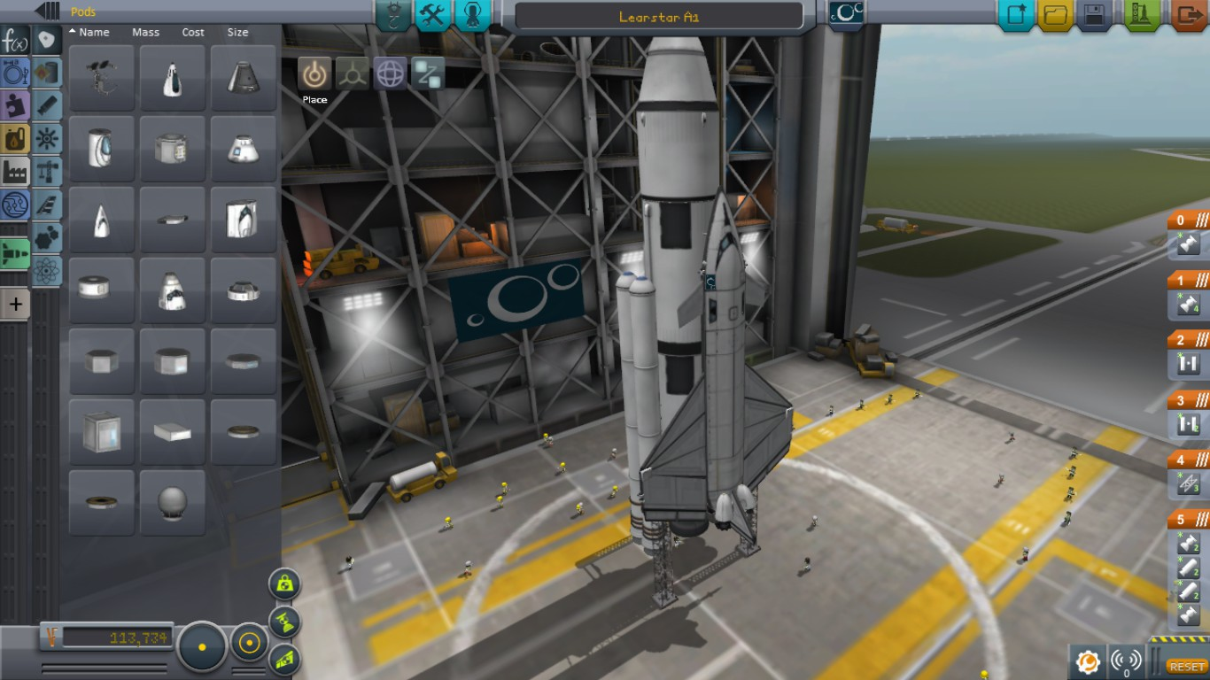
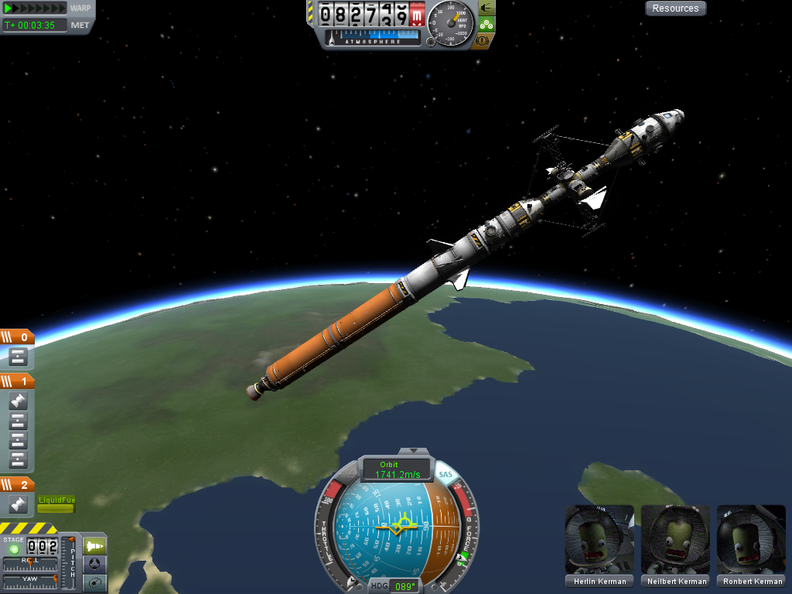
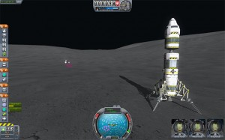
Want to Learn By Building And Flying Your Own?
Google “Kerbal Space Program”

Slide 21
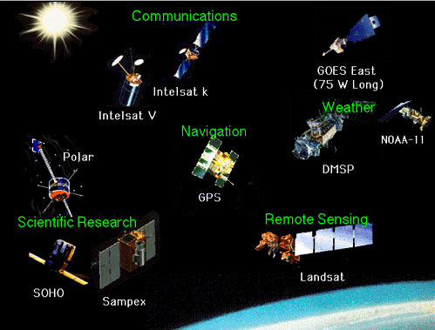
Satellites:
Different
Types

Slide 22
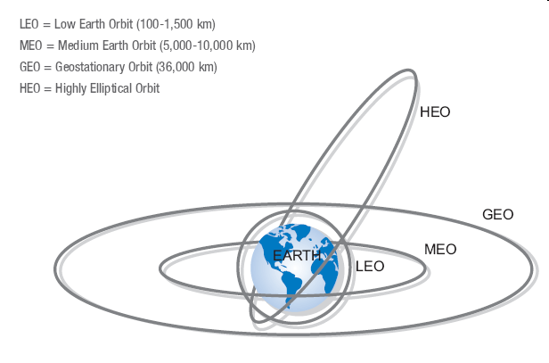
Where are they????
Different Satellites require different
Orbit Types?
LEO
HEO
GEO Synch
POLAR
Sun Synch
Anywhere inbetween

Slide 23
Space Exploration
The future is upon us

Slide 24
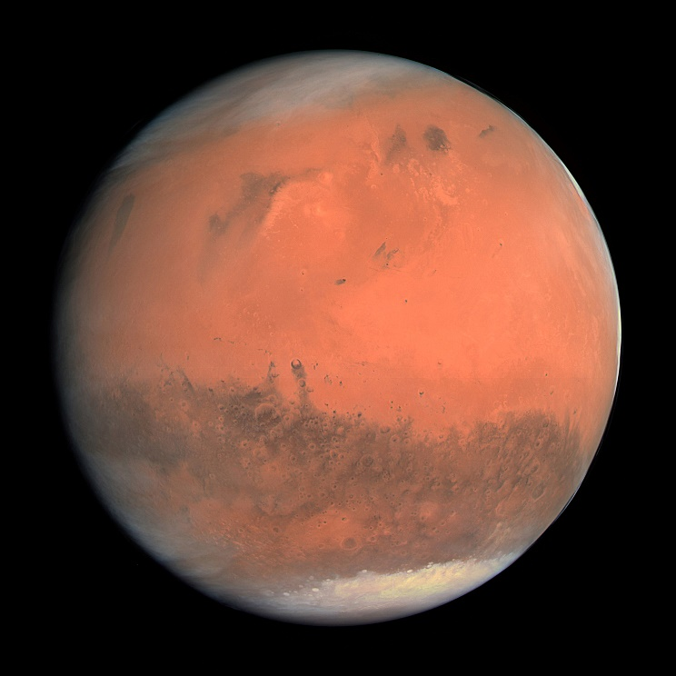
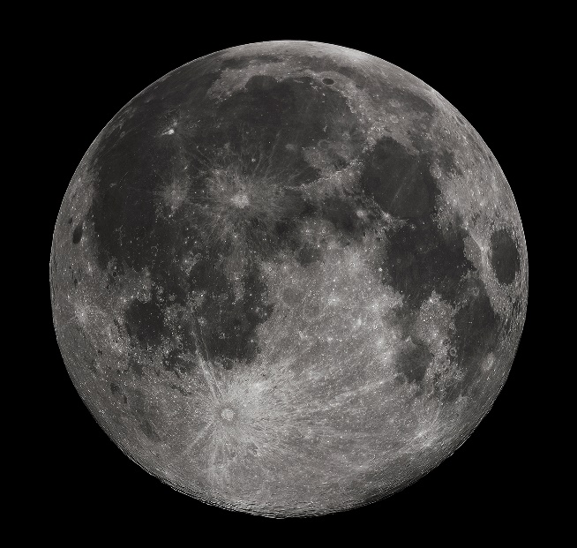
First Stop Mars…
Can’t wait!
By way of moon?
Maybe: There are good reasons to go
back to the moon first.

Slide 25
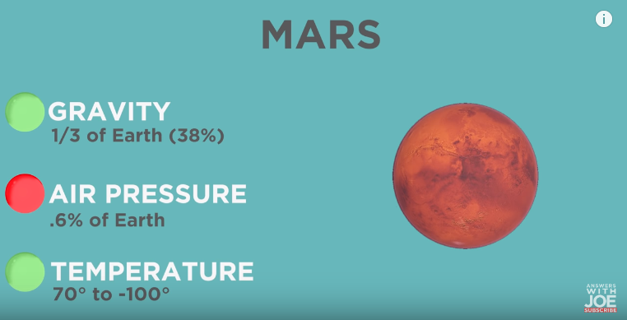
Getting there is only half the battle.
To colonize, we need to be self-sustaining.
Food, Water, Shelter, Fuel,
Protection from Radiation

Slide 26
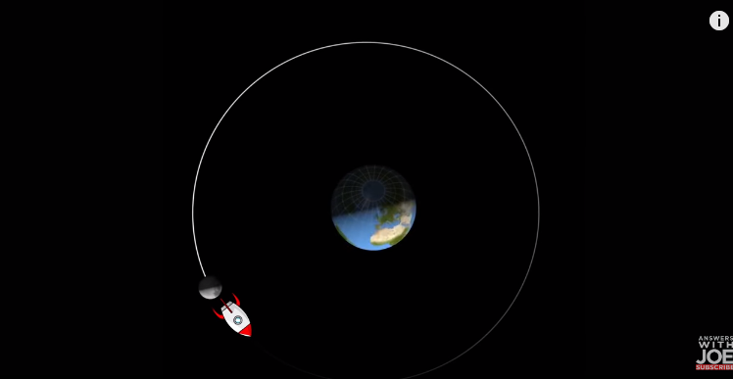
Moon Base
2238mph
Water ice
Instantaneous communication

Slide 27
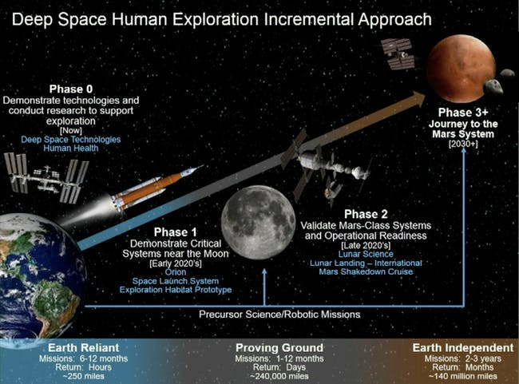

Slide 28
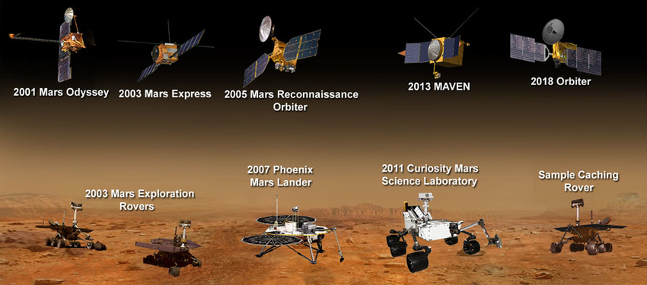

Slide 29
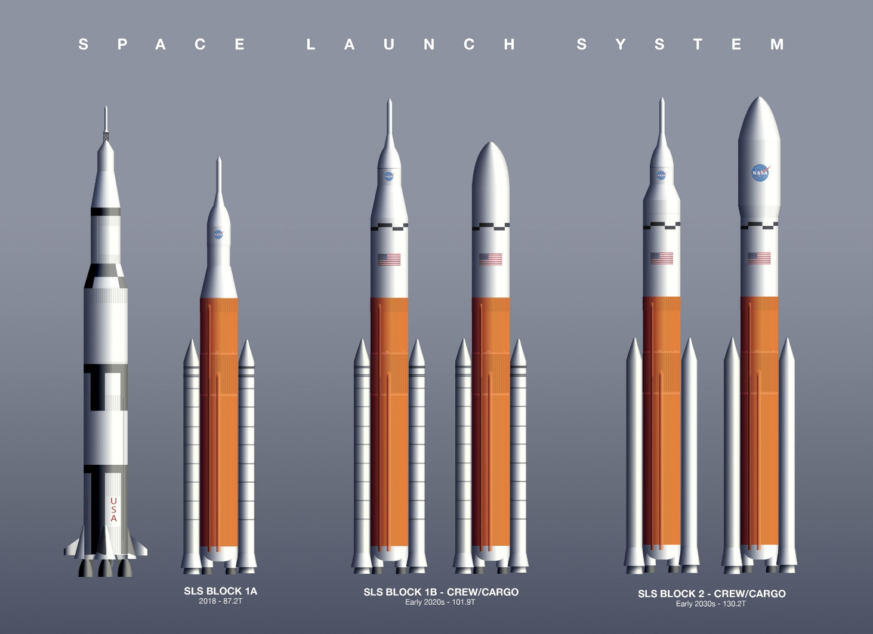
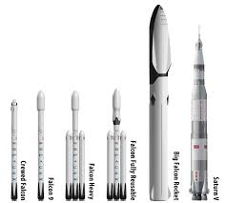
Space Launch System
Space X – Big Falcon Rocket

Slide 30
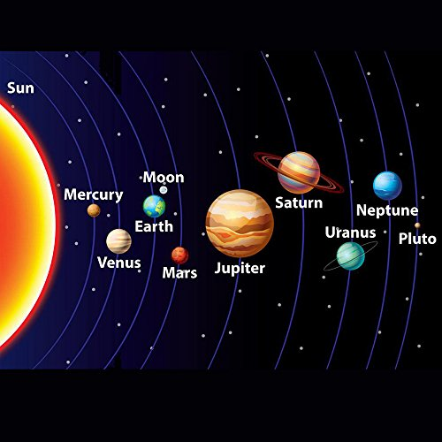
Second Stop??

Slide 31
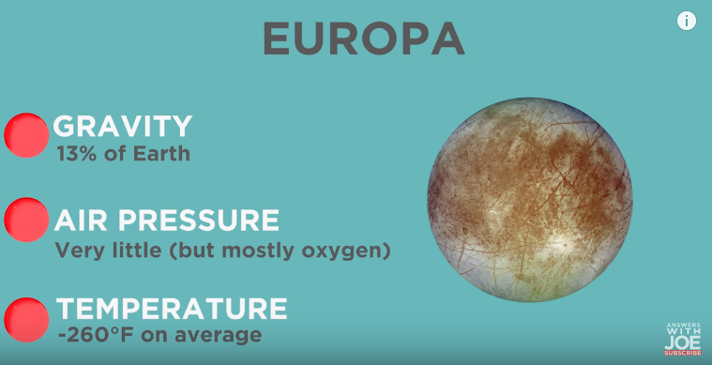
Liquid ocean under ice
Best opportunities to find life
Underwater habitat???
However, Really close to Jupiter. Big gravity sucks in radiation

Slide 32
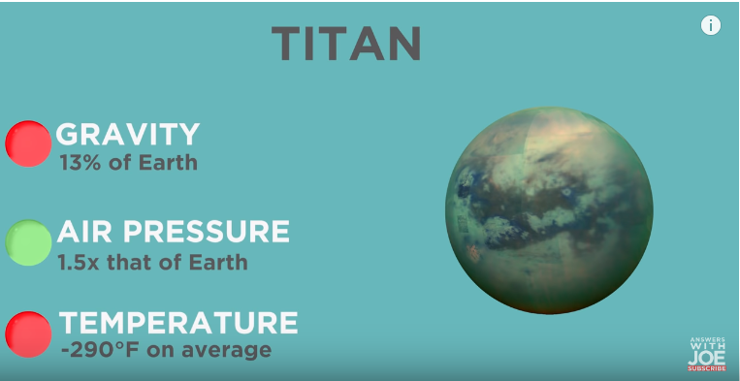
Lots of methane
Great rocket fuel

Slide 33
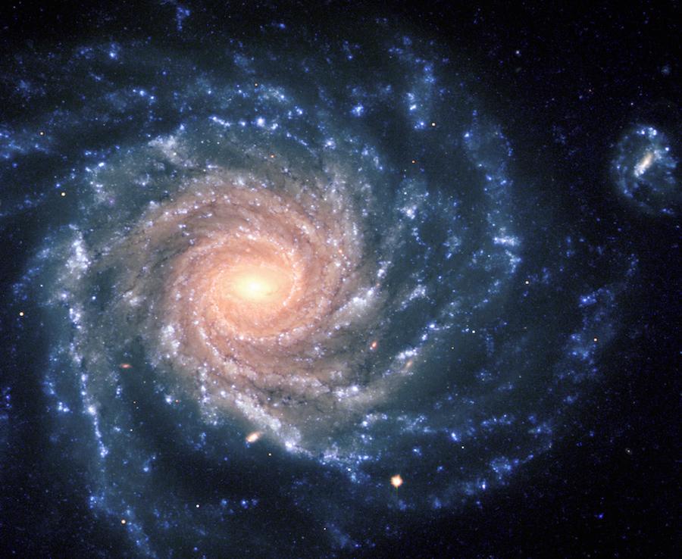
After that??

Slide 34
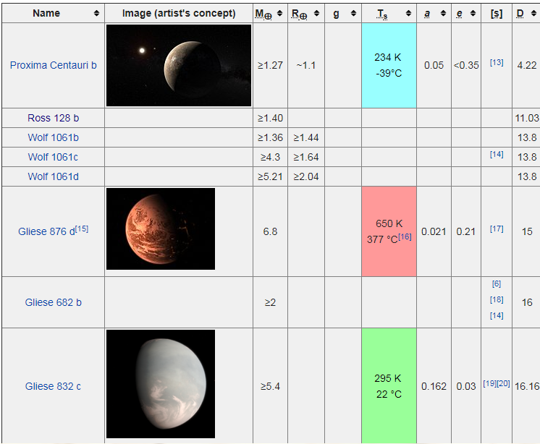
We keep finding more planets in other solar systems.
How do we get there?

Slide 35
But can we really go outside our Solar System?
How long would it take to travel 4 light years?
There are 6 trillion miles in a light-year (approximately), so the distance we need to go is 6 trillion miles / light-year times 4 light-years, or 24 trillion miles.
So, this trip would take 1.2 billion hours.
There are 24 hours a day and 365.25 days per year, so this time in years is
137 thousand years
But wait…

Slide 36
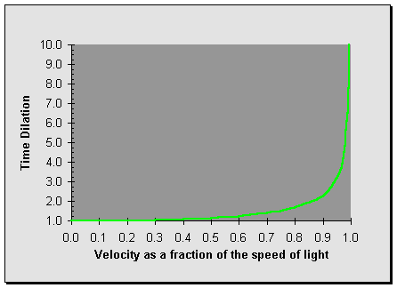
New Type of engines are being conceived of all the time
Just like we went from the cannon idea to liquid engines, there are theoretical engine ideas that can make other solar systems reachable.
And, if you learn about Einstein and his theories on relativity, we can shorten the trip.
And why does time (as we know it) matter if you can go into hibernation.

Slide 37
Bottom Line, the next place we go is up to you!
You are the next generation.
No idea is too crazy.

Slide 38
HOME WORK
Scout Homework After Camporee:
Requirements 5
Requirements 7
Go to the web page for more information
http://troop158va.org/space
Those that did not do Requirements 2 and 8, will need to do those as well.
I will hold onto blue cards. I will get them to your troop via district meetings, or other means.

Slide 39
<<Launch Rockets>>

Slide 40
Requirements

Slide 41
1. Tell the purpose of space exploration and include the following:
a. Historical reasons
b. Immediate goals in terms of specific knowledge
c. Benefits related to Earth resources, technology, and new products.
d. International relations and cooperation
2. Design a collector's card, with a picture on the front and information on the back, about your favorite space pioneer. Share your card and discuss four other space pioneers with your counselor.
3. Build, launch, and recover a model rocket. Make a second launch to accomplish a specific objective Identify and explain the following rocket parts:
Body tube, Engine mount, Fins, Igniter, Launch lug, Nose cone, Payload, Recovery system, Rocket engine
4. Discuss and demonstrate each of the following:
a. The law of action-reaction.
b. How rocket engines work
c. How satellites stay in orbit
d. How satellite pictures of Earth and pictures of other planets are made and transmitted.

Slide 42
5) Do TWO of the following:
a. Discuss with your counselor a robotic space exploration mission and a historic crewed mission. Tell about each mission's major discoveries, its importance, and what was learned from it about the planets, moons, or regions of space explored.
b. Using magazine photographs, news clippings, and electronic articles (such as from the Internet), make a scrapbook about a current planetary mission.
c. Design a robotic mission to another planet or moon that will return samples of its surface to Earth. Name the planet or moon your spacecraft will visit. Show how your design will cope with the conditions of the planet's or moon's environment.
6) Describe the purpose and operation of ONE of the following:
a. Space shuttle or any other crewed orbital vehicle, whether government owned (U.S. or foreign) or commercial
b. International Space Station
7)Design an inhabited base located within our solar system, such as Titan, asteroids, or other locations that humans might want to explore in person. Make drawings or a model of your base. In your design, consider and plan for the following:
a. Source of energy
b. How it will be constructed
c. Life-support system
d. Purpose and function
8 Discuss with your counselor two possible careers in space exploration that interest you. Find out the qualifications, education, and preparation required and discuss the major responsibilities of those positions.

Slide 43
Extras

Slide 44
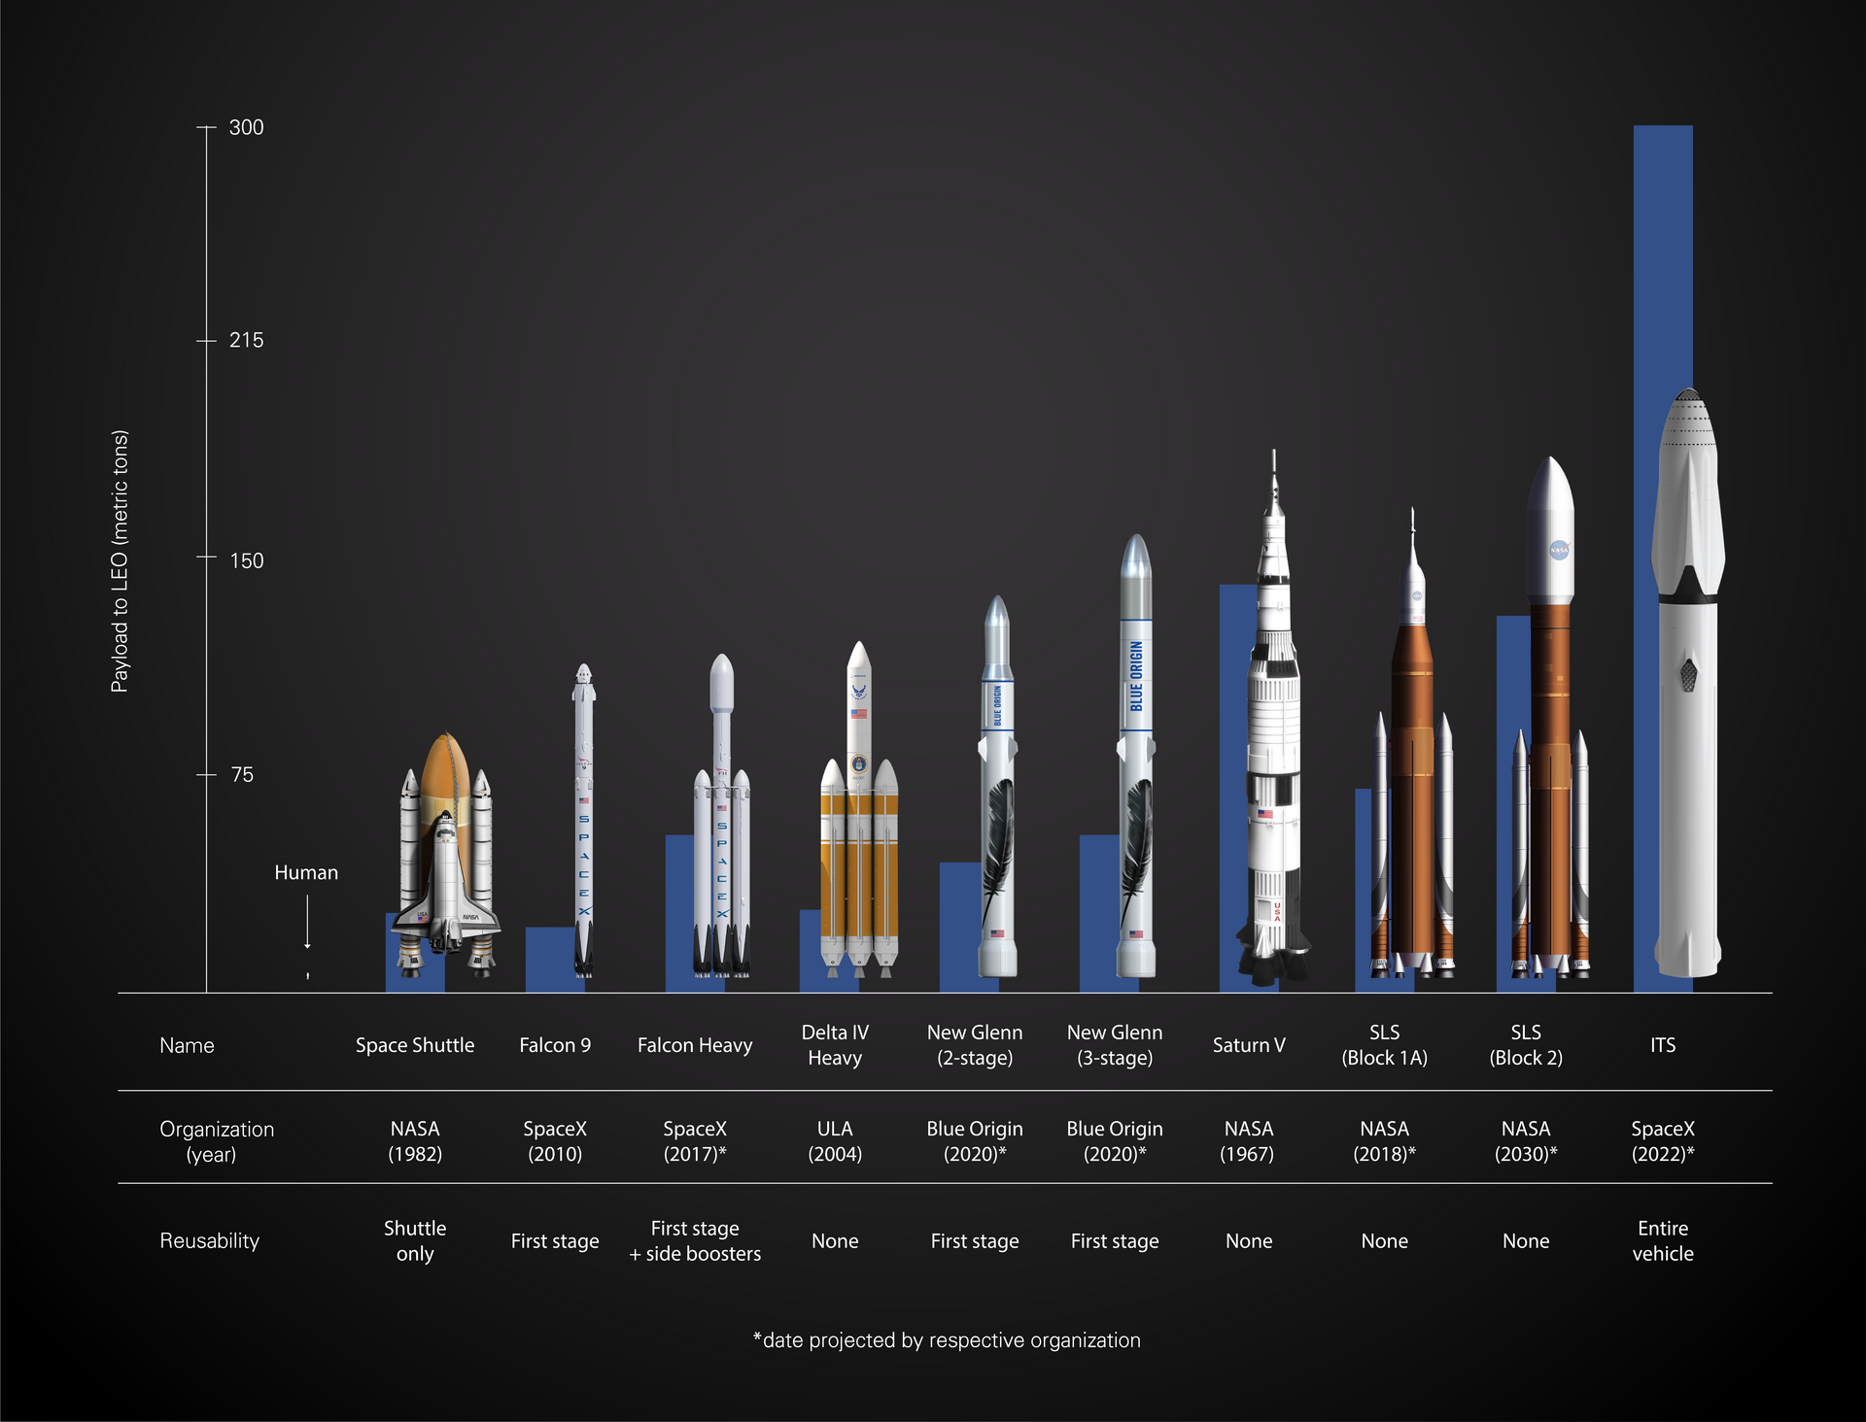

Slide 45
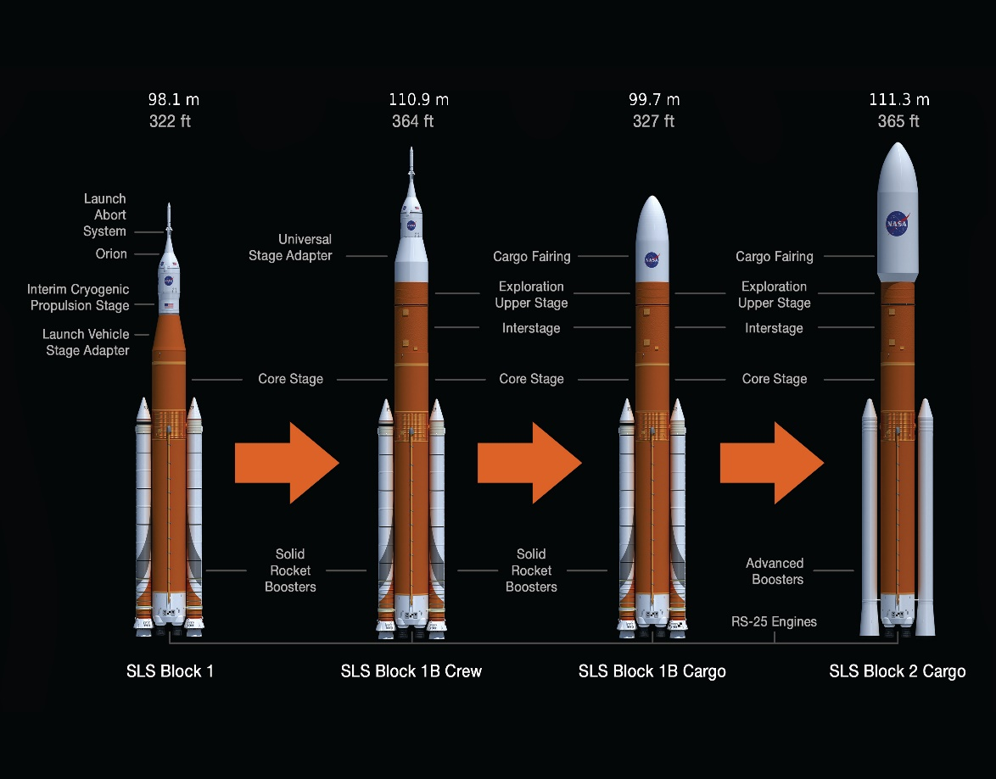
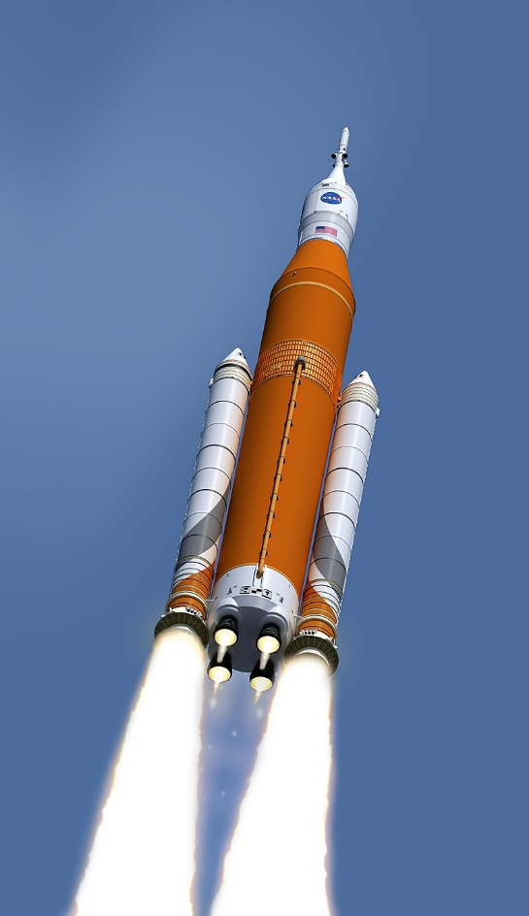

Slide 46
